Slide 1
Sprint 1 Deliverable
Team Yellow
Janet Gregoire, Dakota Kronberger, & Nicholas Roush

Slide 2
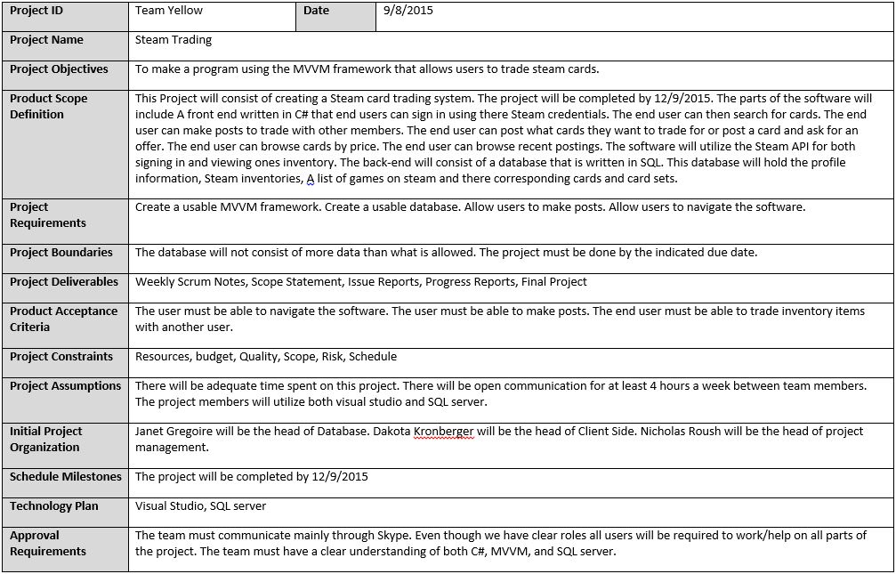
Scope Document

Slide 3
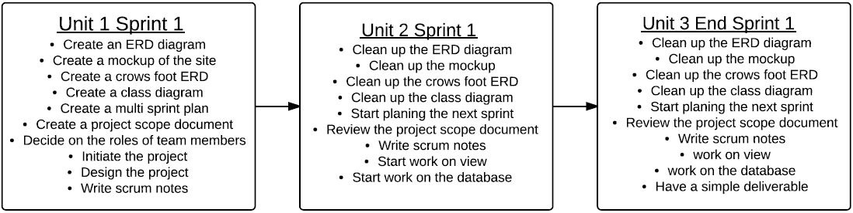
Multi-Sprint Plan

Slide 4
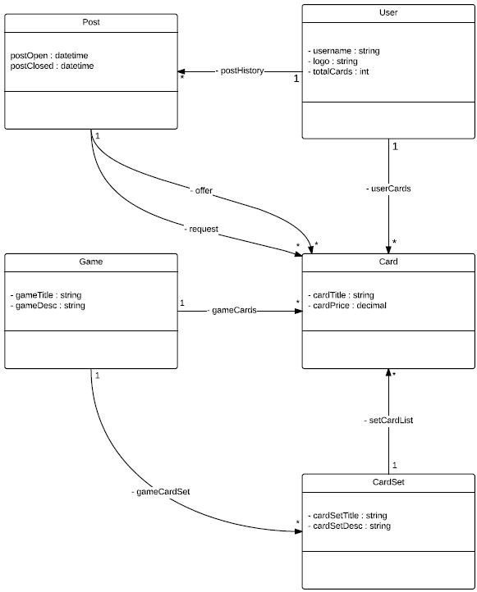
Class ERD

Slide 5
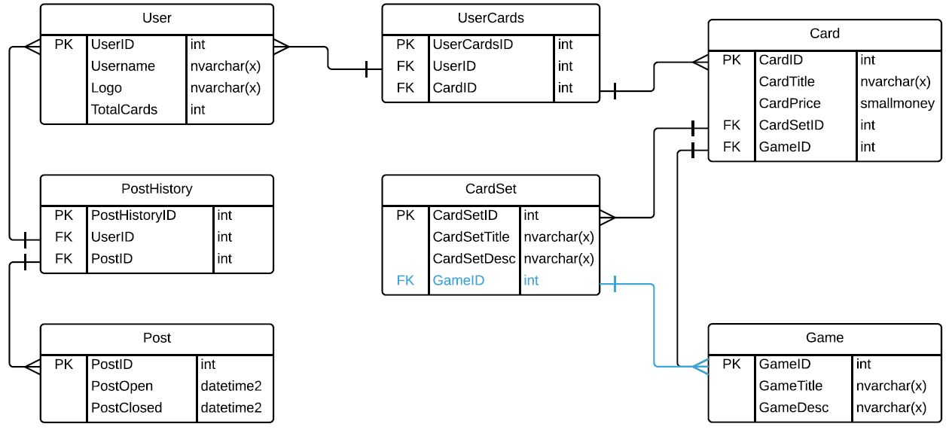
Crow’s Foot ERD

Slide 6
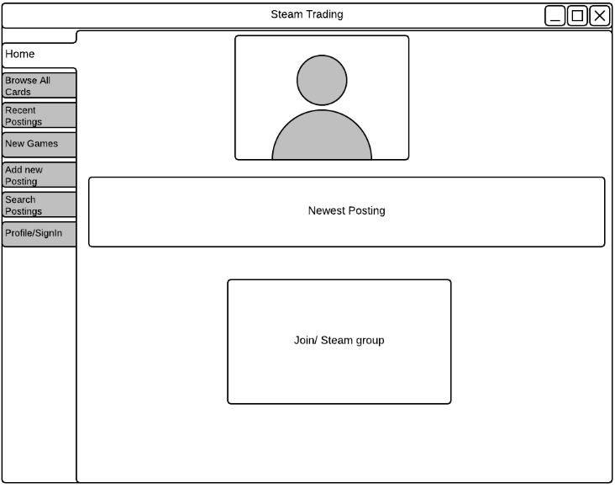
Mockup: Home

Slide 7
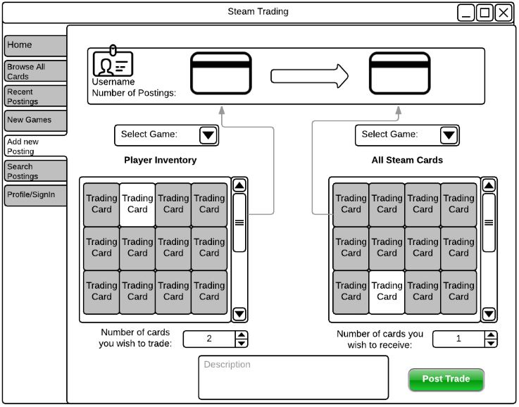
Mockup: Add Post

Slide 8
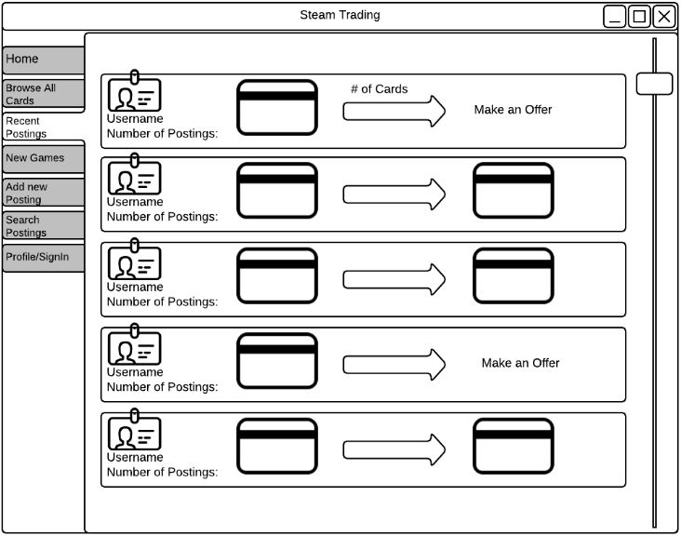
Mockup: Posts

Slide 9
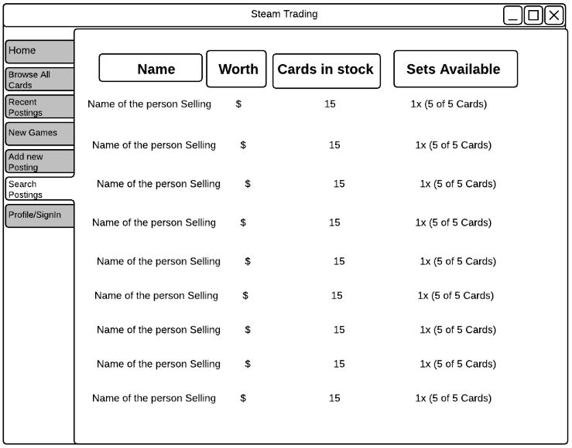
Mockup: Search Posts

Slide 10
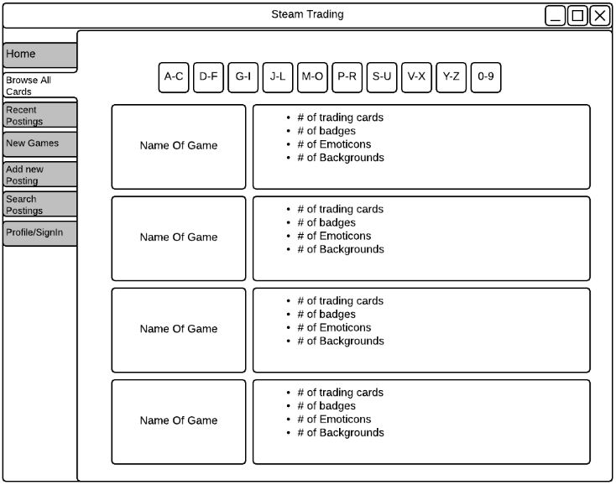
Mockup: Cards

Slide 11
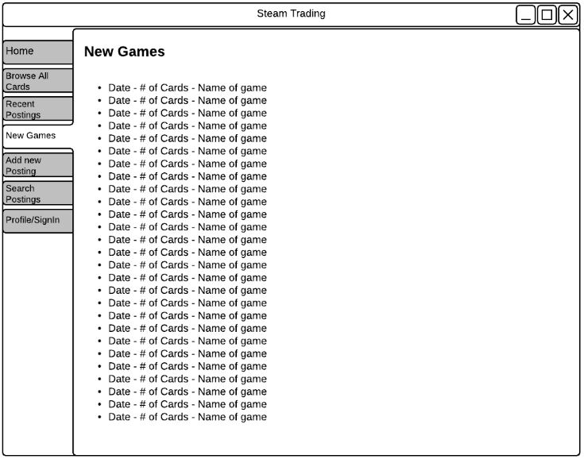
Mockup: Games

Slide 12
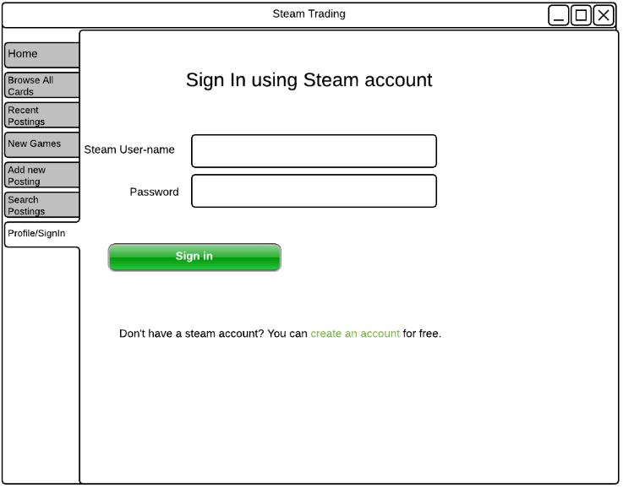
Mockup: Sign In

